Slide 1
BIRD AND ANIMAL SPECIES DETECTION USING ANALYSIS OF AUDIO SIGNALS
BY:
AVIKAL GOEL : 2K19/MC/028
AYUSHI VERMA : 2K19/EC/038

Slide 2
ABSTRACT
Given an unknown audio signal, and a set of reference signals, the task is to find which class of birds and animals (corresponding to the reference signal) does the given signal matches the best.
Concept of correlation will be used to achieve this, as it gives the degree of similarity between 2 signals.
MATLAB will be used for implementation.
Audio signals of various animals and bird species will be imported in MATLAB from various online resources. Kaggle and xeno-canto have rich collection of useful data. They will be referred for the dataset.
The audio signals will be sampled and analysed in frequency domain.
As different animals and birds have a characteristic frequency of voice, the peak frequencies can be related to different animal or bird species.
Once all the signal pre-processing is done, concept of correlation will be used to check the degree of similarity between the test audio signal and the dataset signals.

Slide 3
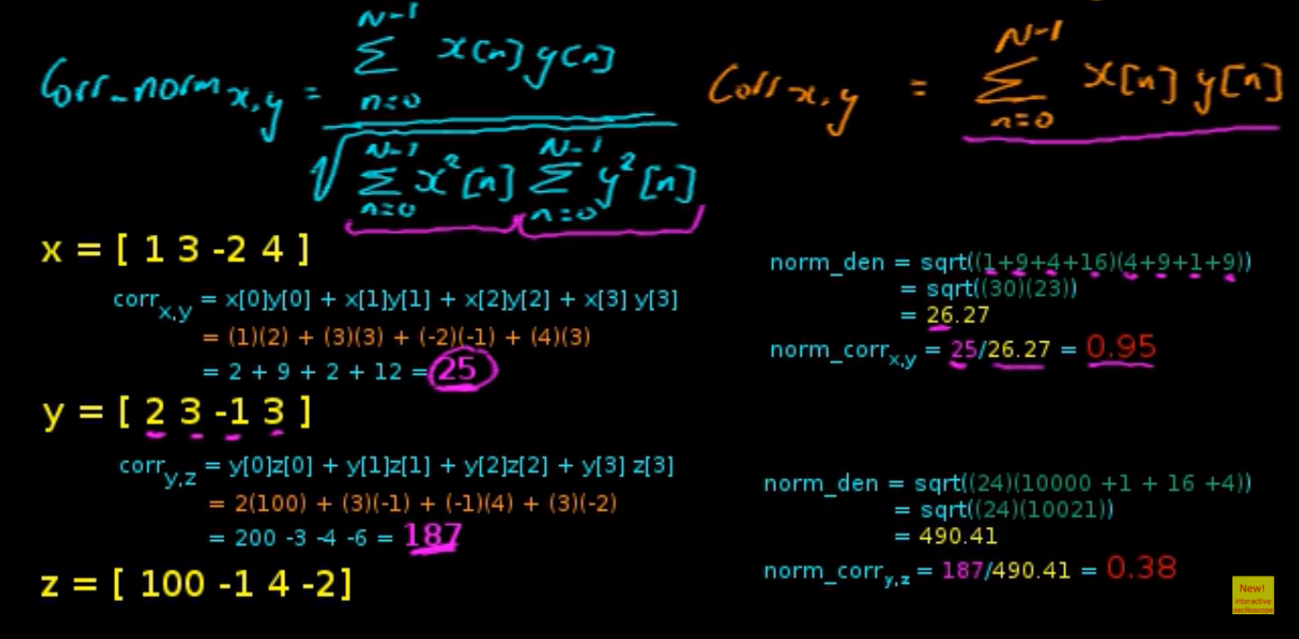
Normalised Correlation

Slide 4
Correlation
Correlation is a statistic that measures the degree to which two variables move in relation to each other.
When two sets of data are strongly linked together, we say they have a High Correlation. The word Correlation is made of Co- (meaning "together"), and Relation. Correlation is positive when the values increase together, and. Correlation is Negative when one value decreases as the other increases.
MATLAB function: r = xcorr(x , y )
It returns the cross-correlation of two discrete-time sequences. Cross-correlation measures the similarity between a vector x and shifted (lagged) copies of a vector y as a function of the lag.

Slide 5
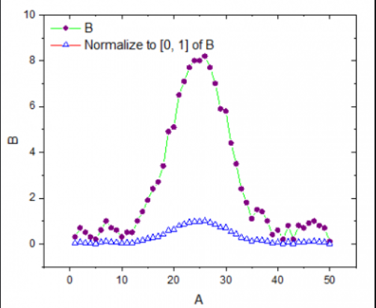
NORMALISATION
Normalization is used to scale the data of an attribute so that it falls in a smaller range, such as -1.0 to 1.0 or 0.0 to 1.0. It is generally useful for classification algorithms.
The output of Fourier transform of signal must be normalised so that all the reference audios may have the same maximum amplitude. So that errors in classification due to different amplitudes of bird speaking may be reduced.
Function used: Nr = normalize(A,'range’) (scale A so that its range is in the interval [0,1]).

Slide 6
Future Scope and real-life application:
If we are able to detect whether the test signal is of a bird, this project can be used as a scare-crow in agricultural farms for bird detection. This will be implemented in project by using some script which can alert if the detected signal is of a bird.
The expected outcome/aim of the project will be to be able to correctly identify the unknown audio signal by matching it to one of the signals in the reference audio signal set, by means of correlation.

Slide 7
Work done till now…
Site referred for download audio files of various birds and animal species: https://www.xeno-canto.org/explore?query=area%3A%22asia%22%20cnt%3A%22India%22
Audio files for analysis have been imported.
Time domain analysis, frequency domain analysis has been done.
Correlation has been implemented using xcorr() function of matlab.
Correct implementation of xcorr() has been verified.

Slide 8
Work left to be done…
Increasing dataset for audio birds/animals for which classification has to be done.
Implementing correlation for a test signal to be classified among a given set of reference signals.
Implementing bird detection alert system (for real life atert system application, like scarecrow) in matlab on detection of bird.

